Slide 1





Cyber Offense and Defense
HTTP request smuggling
Group 1
HTTP request smuggling
HTTP request smuggling
Cangeri Fabio 249495
Falvo Paolo 223974
Gebreslassie Hilary 241696
Vecchio Francesco 219901
Main References
https://portswigger.net/web-security/request-smuggling#what-is-http-request-smuggling

Slide 2
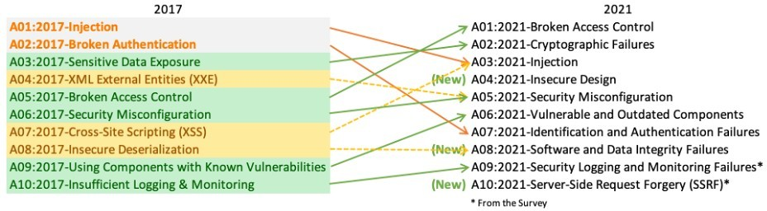
OWASP Top Ten
A broad consensus about the most critical security risks to web applications
https://owasp.org/
A6:2017-Security Misconfiguration
Security misconfiguration is the most commonly seen issue. This is commonly a result of insecure default configurations, incomplete or ad hoc configurations, open cloud storage, misconfigured HTTP headers, and verbose error messages containing sensitive information. Not only must all operating systems, frameworks, libraries, and applications be securely configured, but they must be patched/upgraded in a timely fashion.
A05:2021-Security Misconfiguration
moves up from #6 in the previous edition; 90% of applications were tested for some form of misconfiguration, with an average incidence rate of 4.5%, and over 208k occurrences of CWEs mapped to this risk category. With more shifts into highly configurable software, it's not surprising to see this category move up. The former category for A4:2017-XML External Entities (XXE) is now part of this risk category.

Slide 3
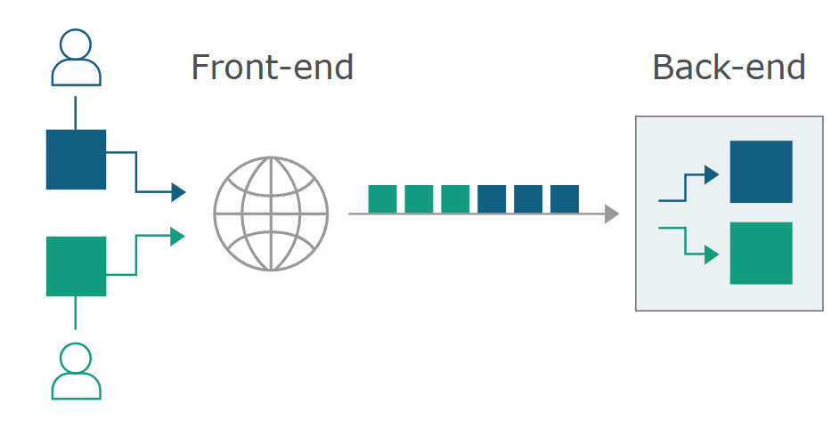
HTTP request smuggling
HTTP request smuggling is a technique for interfering with the way a web site processes sequences of HTTP requests that are received from one or more users.
When the front-end server forwards HTTP requests to a back-end server, it typically sends several requests over the same back-end network connection, because this is much more efficient and performant. The protocol is very simple; HTTP requests are sent one after another, and the receiving server has to determine where one request ends and the next one begins

Slide 4
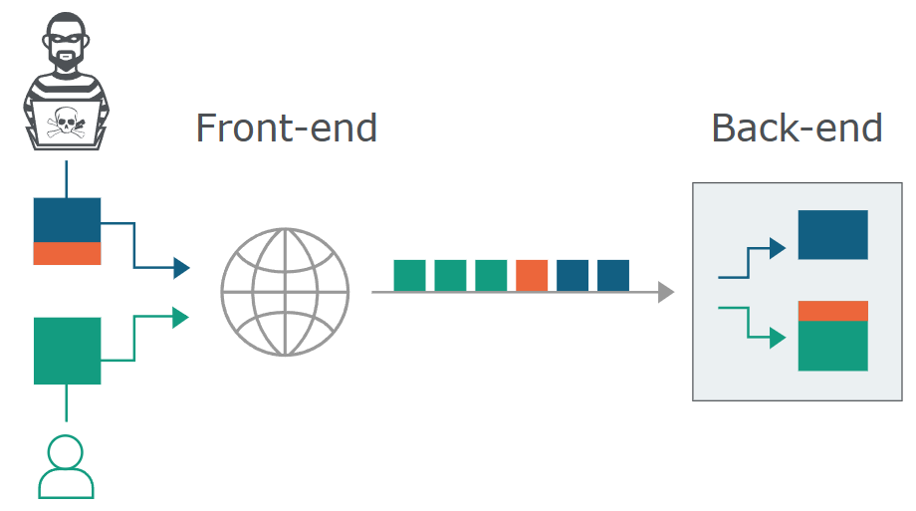
HTTP request smuggling
It is crucial that the front-end and back-end systems agree about the boundaries between requests. Otherwise, an attacker might be able to send an ambiguous request that gets interpreted differently by the front-end and back-end systems

Slide 5
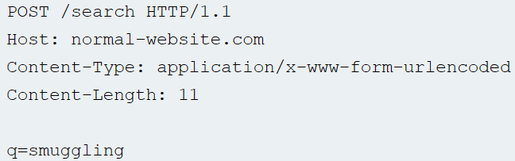
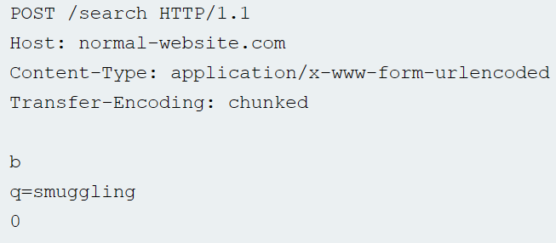
Most HTTP request smuggling vulnerabilities arise because the HTTP/1 specification provides two different ways to specify where a request ends:
Content-Length: it specifies the length of the message body in bytes
Transfer-Encoding: used to specify that the message body uses chunked encoding
After specify the size of the chunk, the next line will contain the real content. If the chunk is 0, the next line has to be empty

Slide 6
HTTP/1 specification provides two different methods for specifying the length of HTTP messages.
If both the Content-Length and Transfer-Encoding headers are present, then the Content-Length header should be ignored
Some servers do not support the Transfer-Encoding header in requests
Some servers that do support the Transfer-Encoding header can be induced not to process it if the header is obfuscated in some way.
This might be sufficient to avoid ambiguity when only a single server is in play, but not when two or more servers are chained together
The front-end and back-end servers might disagree about the boundaries between successive requests, leading to request smuggling vulnerabilities.

Slide 7
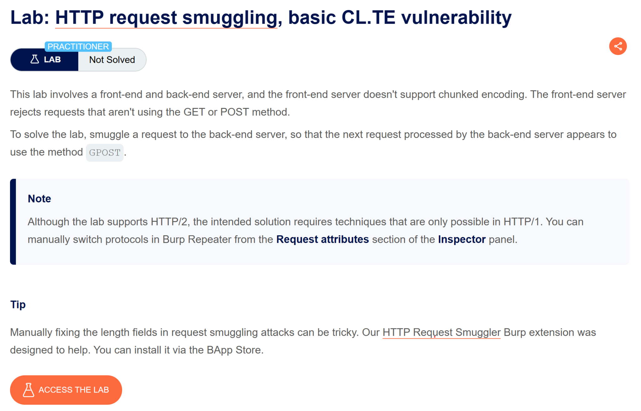

ZAP
"\r" (carriage return)
"\n" (line feed)
"\r\n" is the sequence that indicates the end of a line in the HTTP header
LAB
SOLUTION

Slide 8
How to obfuscate the Transfer-Encoding header
Transfer-Encoding: xchunked
Transfer-Encoding : chunked
Transfer-Encoding: chunked
Transfer-Encoding: x
Transfer-Encoding:[tab]chunked
[space]Transfer-Encoding: chunked
X: X[\n]Transfer-Encoding: chunked
Transfer-Encoding
: chunked

Slide 9
Cyber Offense and Defense
Identifying and exploiting the vulnerability
Main References
https://portswigger.net/web-security/request-smuggling/finding
https://portswigger.net/web-security/request-smuggling/exploiting

Slide 10
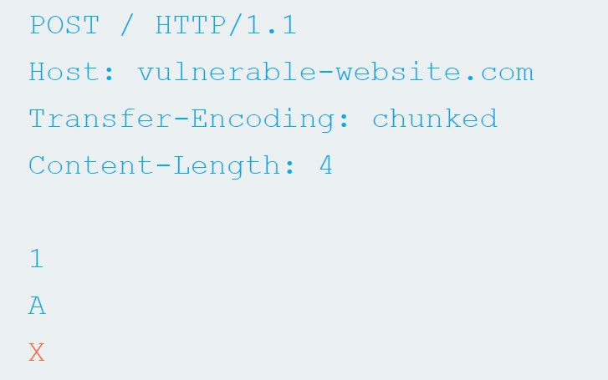
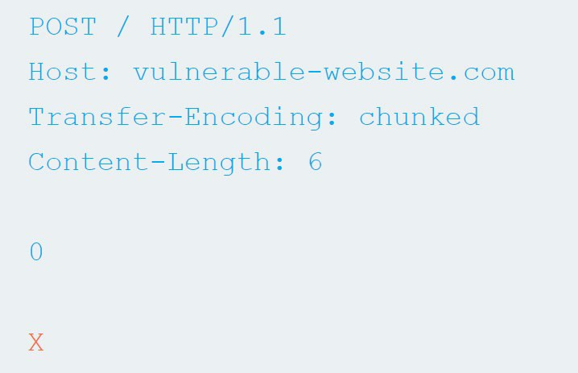
Identifying the vulnerability:
usually it is sufficient to make the application behave differently, for example causing a timeout.
CL.TE: encode the right CL and don’t close the chunk.
TE.CL: make an empty chunk but use bigger length.
Keep in mind that the red part of the body will NOT be sent to the backend and will remain pending in the «stack» of the frontend

Slide 11
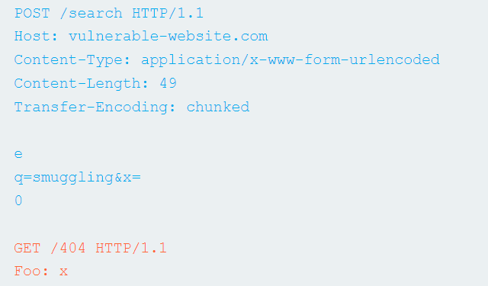
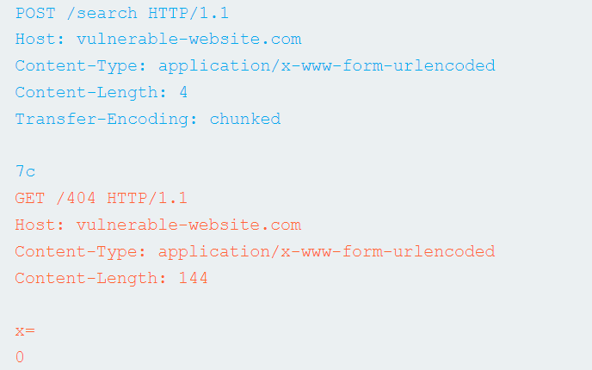
Confirming
the vulnerability
After the test to find the vulnerability has been passed, we can definitely
confirm the presence of it trying to actual smug a request.
To do so, we can try to append a «GET 404» request, so that the next request will get this error even if it was done to a correct endpoint. To be able to observate this, we have to make sure that we are the one who get the error.
CL.TE
TE.CL

Slide 12
Important to note
Due to load balancers or high traffic, multiple attempts may be necessary if requests are routed differently or not subsequent.
Conducting multiple attempts might cause harm to other users.
To ensure certainty in identifying the vulnerability, the attacking request and the normal one should come from two different connections; otherwise, it's not secure.
The two requests should be as similar as possible to avoid redirection to different backend servers (URLs and parameters).

Slide 13
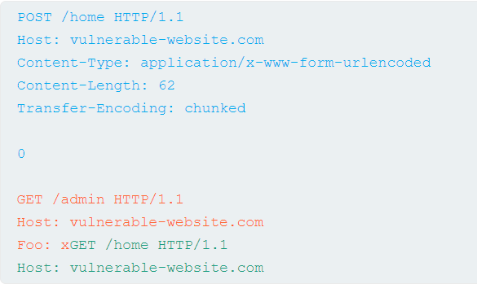
Bypass front-end security
When access controls are done only in the front-end server but not on the back-end server
Front-end
Back-end
/home
Both request as /home
/admin

Slide 14
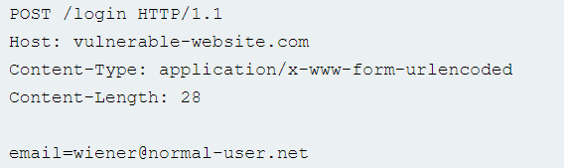

Revealing front-end request rewriting
Understanding how the front end adds the header and rewrite when we do the smuggle

Slide 15
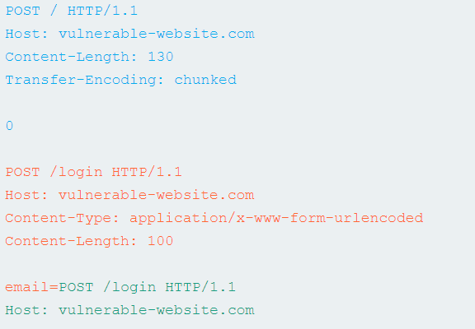
Revealing front-end request rewriting
Smuggle post request
Shuffle parameter “email” so it appears last in-message body

Slide 16
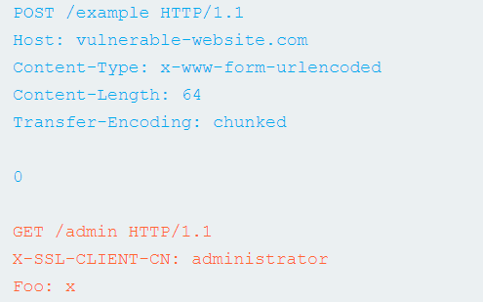
Bypassing client authentication
This certificate contains their "common name" (CN), which should match their registered hostname.

Slide 17
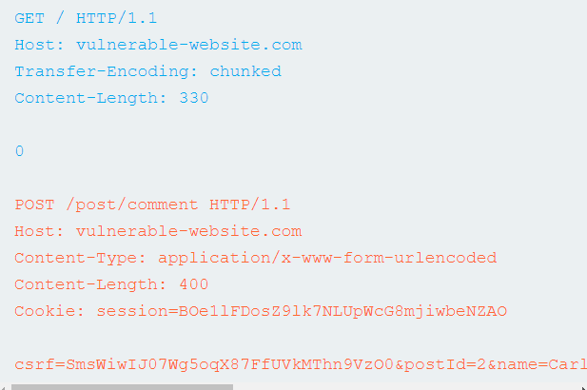
Capturing other users' requests

Slide 18
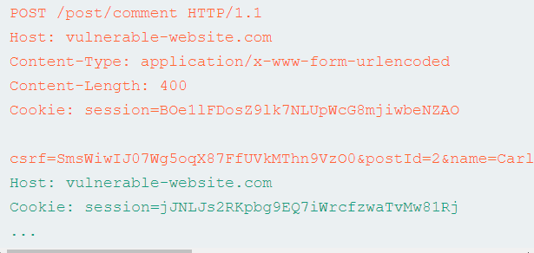
Capturing other users' requests

Slide 19
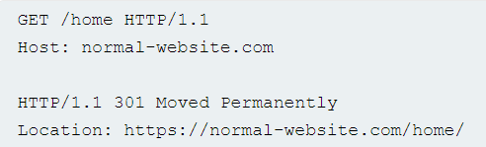
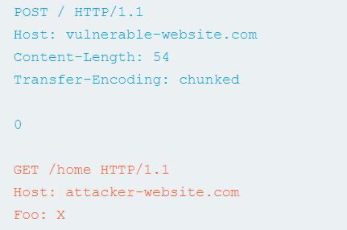
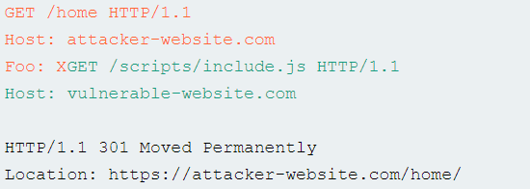
Using HTTP request smuggling to turn an on-site redirect into an open redirect
Attacker smuggles request
Victim’s request

Slide 20
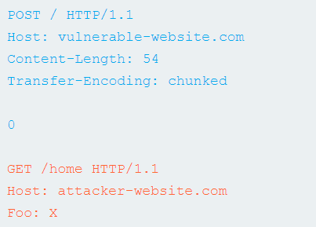
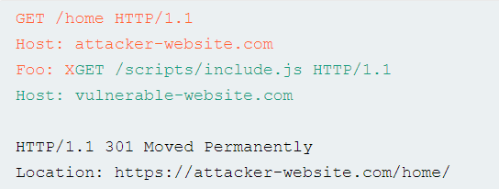
Using HTTP request smuggling to perform web cache poisoning
Redirect to an external domain

Slide 21
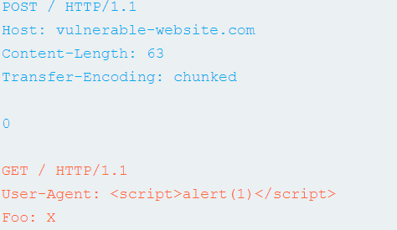
Using HTTP request smuggling to exploit reflected XSS

Slide 22
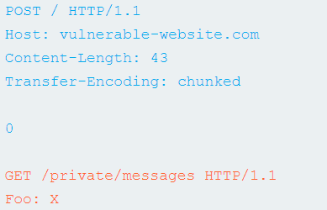
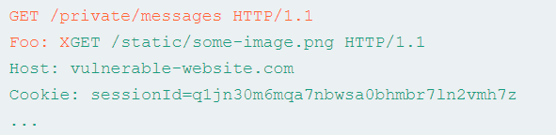
Using HTTP request smuggling to perform web cache deception
Attacker uses this URL to gain content

Slide 23
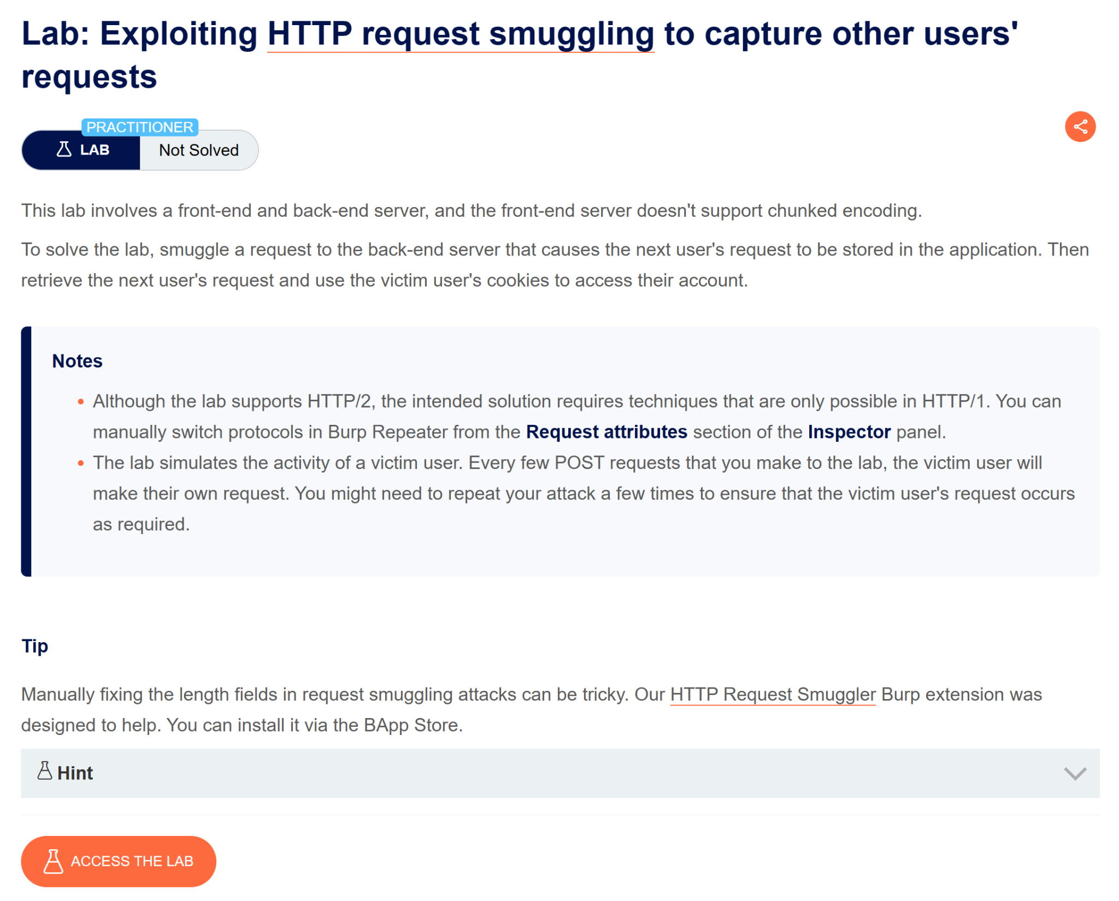
LAB
LAB
LAB
SOLUTION
SOLUTION

Slide 24
Cyber Offense and Defense
Prevention
Main References
https://portswigger.net/web-security/request-smuggling#how-to-prevent-http-request-smuggling-vulnerabilities

Slide 25
How to prevent HTTP request smuggling vulnerabilities
Use HTTP/2 end to end and disable HTTP downgrading if possible. HTTP/2 uses a robust mechanism for determining the length of requests and, when used end to end, is inherently protected against request smuggling.
Make the front-end server normalize ambiguous requests and make the back-end server reject any that are still ambiguous, closing the TCP connection in the process.
Never assume that requests won't have a body. This is the fundamental cause of both CL.0 and client-side desync vulnerabilities.
Default to discarding the connection if server-level exceptions are triggered when handling requests.
If you route traffic through a forward proxy, ensure that upstream HTTP/2 is enabled if possible.

Slide 26

How to prevent HTTP request smuggling vulnerabilities
HTTP request smuggling vulnerabilities arise in situations where the front-end server and back-end server use different mechanisms for determining the boundaries between requests.

Slide 27
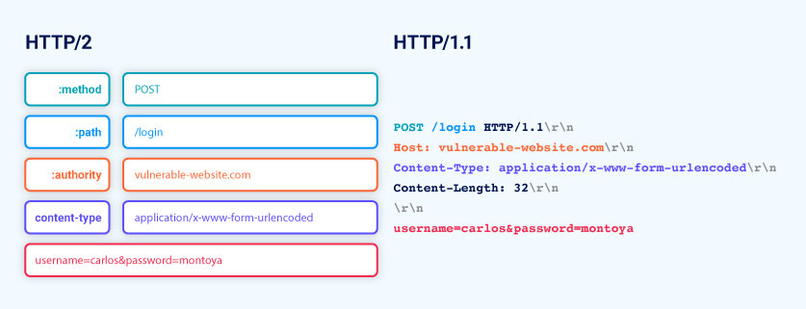
HTTP/2 downgrading
In HTTP/2 environments, the common practice of downgrading HTTP/2 requests for the back-end is also fraught with issues and enables or simplifies a number of additional attacks.
HTTP/2 downgrading, where servers convert HTTP/2 messages to HTTP/1 syntax, is common and often default in many reverse proxy services. Some services don't offer an option to disable this feature.

Slide 28
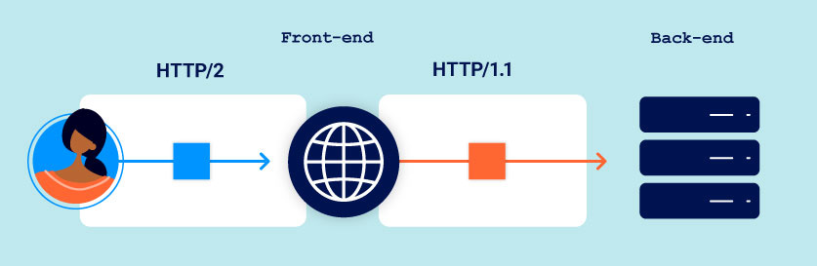
HTTP/2 downgrading
Web servers supporting HTTP/2 often convert incoming HTTP/2 requests into HTTP/1 format to communicate with legacy back-end systems that only understand HTTP/1.
When an HTTP/1 back-end responds, the front-end server translates it into an HTTP/2 response for the client, as both protocols represent the same information differently.
HTTP/2 downgrading to HTTP/1 can lead to request smuggling due to its three different length specification methods, exploiting mismatches and vulnerabilities not present in end-to-end HTTP/2 usage.

Slide 29
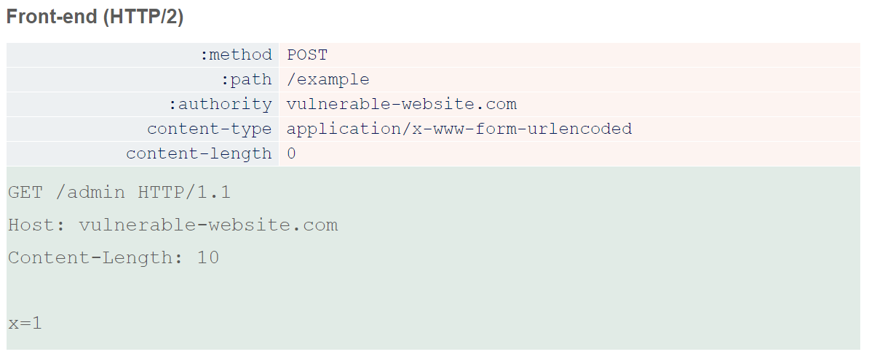
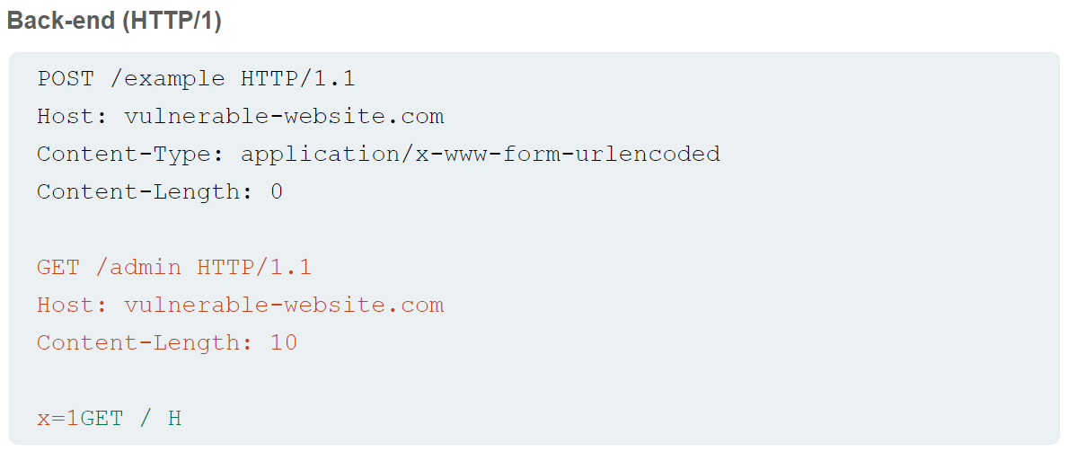
H2.CL vulnerabilities
During HTTP/2 to HTTP/1 downgrading, front-end servers may add an HTTP/1 Content-Length header based on HTTP/2's length mechanism. If HTTP/2 requests include their own content-length header, some servers reuse this value in the downgraded HTTP/1 request.
The HTTP/2 spec requires matching content-length headers with its built-in length, but improper validation before downgrading can lead to request smuggling. Injecting a misleading content-length header can cause a desync, as the front-end uses HTTP/2 length, while the HTTP/1 back-end relies on the derived Content-Length, leading to potential security vulnerabilities.

Slide 30


Questions

